Slide 1
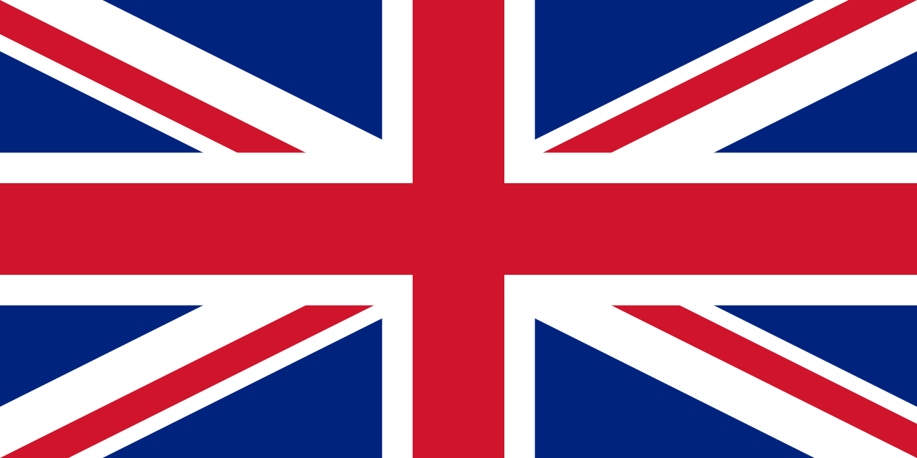
UK Monuments

Slide 2
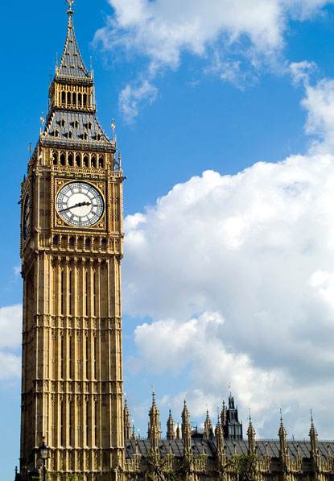
Big Ben
Big Ben is the nickname for the Great Bell of the clock at the north end of the Palace of Westminster in London, and often extended to refer to the clock and the clock tower.
The tower holds the second largest four-faced chiming clock in the world (Minneapolis City Hall being the largest).
The tower was completed in 1858 and had its 150th anniversary on 31 May 2009, during which celebratory events took place. The tower has become one of the most prominent symbols of the United Kingdom and is often in the establishing shot of films set in London.
The tower is officially known as the Elizabeth Tower, renamed as such to celebrate the Diamond Jubilee of Elizabeth II (prior to being renamed in 2012 it was known simply as "Clock Tower").

Slide 3
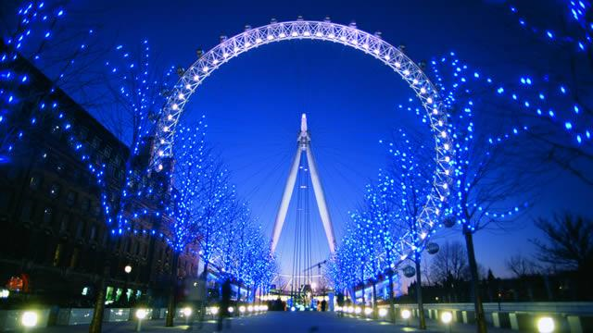
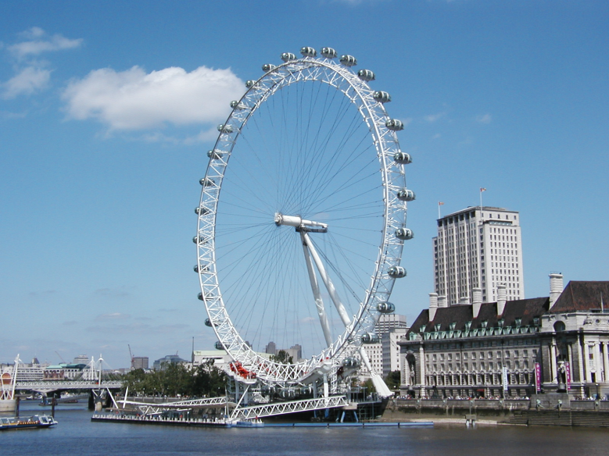
The London Eye
The London Eye is a giant Ferris wheel on the South Bank of the River Thames in London. Also known as the Millennium Wheel. The entire structure is 135 meters (443 ft) tall and the wheel has a diameter of 120 metres (394 ft).
It is currently Europe's tallest Ferris wheel, and offered the highest public viewing point in London until it was superseded by the 245-metre (804 ft) observation deck on the 72nd floor of The Shard.
It is the most popular paid tourist attraction in the United Kingdom with over 3.5 million visitors annually, and has made many appearances in popular culture.
When erected in 1999 it was the world's tallest Ferris wheel. Supported by an A-frame on one side only, the Eye is described by its operators as "the world's tallest cantilevered observation wheel".

Slide 4
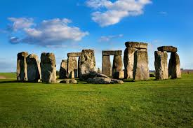
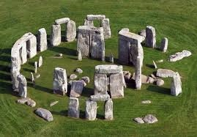
Stonehenge
Stonehenge is a prehistoric monument located in Wiltshire, England. One of the most famous sites in the world, Stonehenge is the remains of a ring of standing stones set within earthworks. It is in the middle of the most dense complex of Neolithic and Bronze Age monuments in England, including several hundred burial mounds.
It is a national legally protected Scheduled Ancient Monument. Stonehenge is owned by the Crown and managed by English Heritage, while the surrounding land is owned by the National Trust.
Archaeologists believe it was built anywhere from 3000 BC to 2000 BC. Radiocarbon dating in 2008 suggested that the first stones were raised between 2400 and 2200 BC, whilst another theory suggests that bluestones may have been raised at the site as early as 3000 BC.

Slide 5
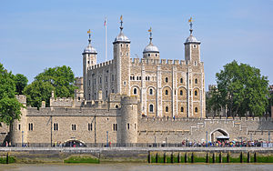
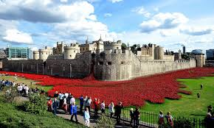
Tower of London
Her Majesty's Royal Palace and Fortress, known as the Tower of London, is a historic castle located on the north bank of the River Thames in central London. It lies within the London Borough of Tower Hamlets, separated from the eastern edge of the square mile of the City of London by the open space known as Tower Hill. It was founded towards the end of 1066 as part of the Norman Conquest of England.
The White Tower, which gives the entire castle its name, was built by William the Conqueror in 1078, and was a resented symbol of oppression, inflicted upon London by the new ruling elite.

Slide 6
There are many other UK landmarks, here are a few of them…

Slide 7
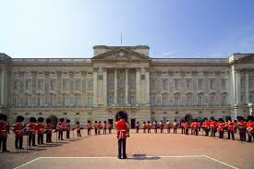
Buckingham Palace

Slide 8
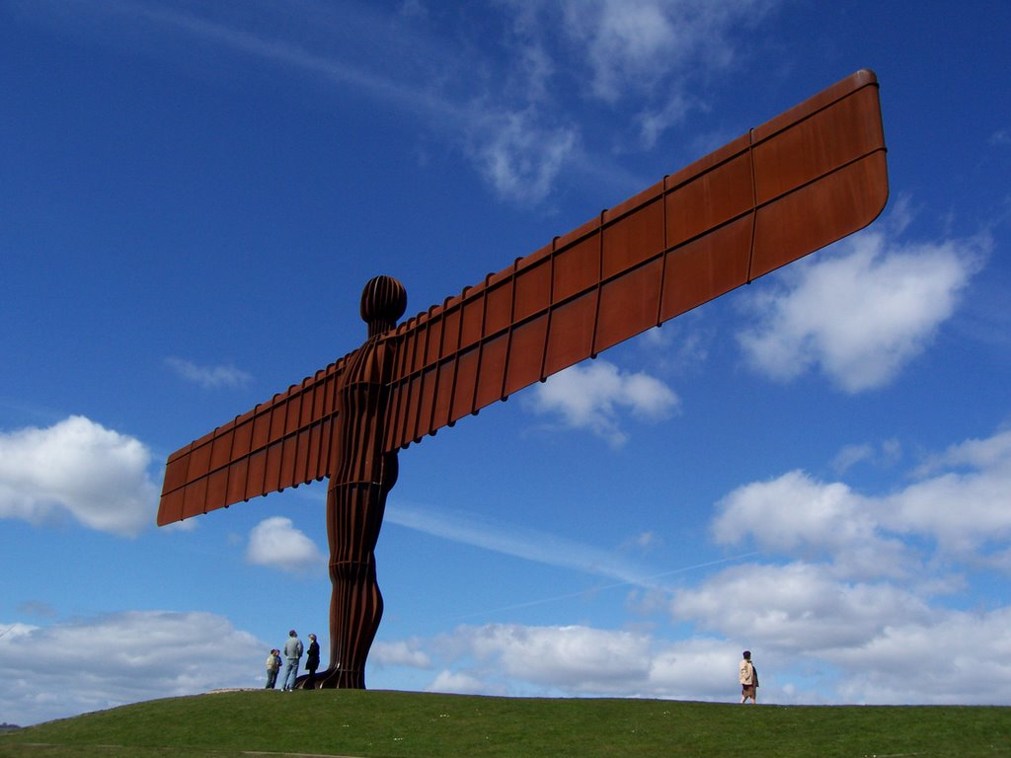
The angel of the North

Slide 9
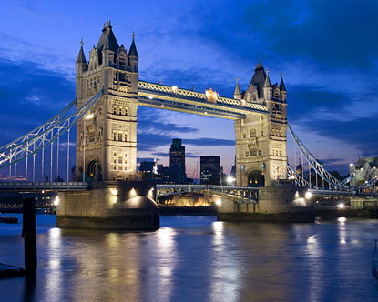
Tower Bridge

Slide 10
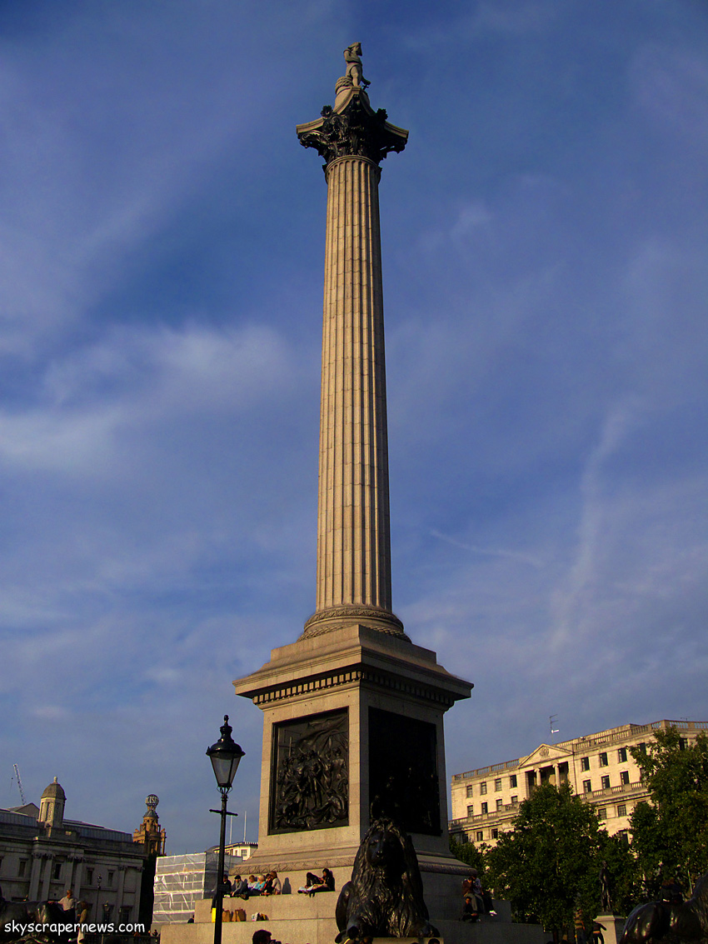
Nelson’s Column

