Slide 1
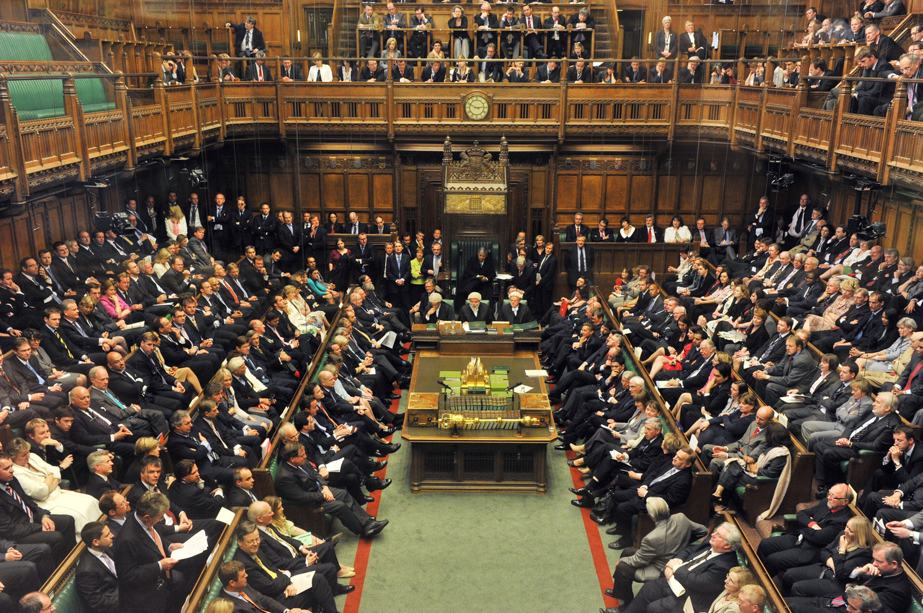
The British Government

Slide 2
Healthcare, Education, The Environment, International aid and Crime. Issues affecting all British peoples lives that are shaped and driven by Parliament. But how did it all begin? What does parliament do all day? And how do the people fit in?

Slide 3
Parliament has evolved throughout it’s long history to become what it has today. Changing over time to meet the needs of the British people. Two key historical events began this process.

Slide 4
In 1215 King John put his seal on Magna Carta, and agreed to a list of 63 rules set out by a group of barons. This ensured for the first time that no one, not even the king was above the law.

Slide 5
50 years later for the first time representatives of the towns and shires were called to parliament. These events are what established the foundations of the represented democracy the British have today.

Slide 6
Modern day British Parliament is made up of three parts. The House of Commons, the House of Lords and the Monarch. The House of Commons is were people who have been elected by the public debate big issues, propose laws, emend existing ones and challenge the governments work.

Slide 7
There are 650 members of parliament, who each represent a constituency in the UK. They belong to a political party or are independent and are elected by people form the area they want to represent.

Slide 8
The leader of the party that has the most MP’s elected after a general election becomes the Prime Minister and heads up the government. They chose a cabinet made up of 20 senior ministers, who co-ordinate each government departments work. Parties not in power are called the opposition. MP’s from the opposition and the government question the government on policy and proposed laws. The speaker keeps the house in order by chairing these debates.

Slide 9
The House of Lords is the second chamber and shares the makings and shaping's of laws with the House of Commons. It has around 800 members. Lords are selected for their knowledge and experience and hold government to account using their expertise to look at laws and issues in detail.

Slide 10
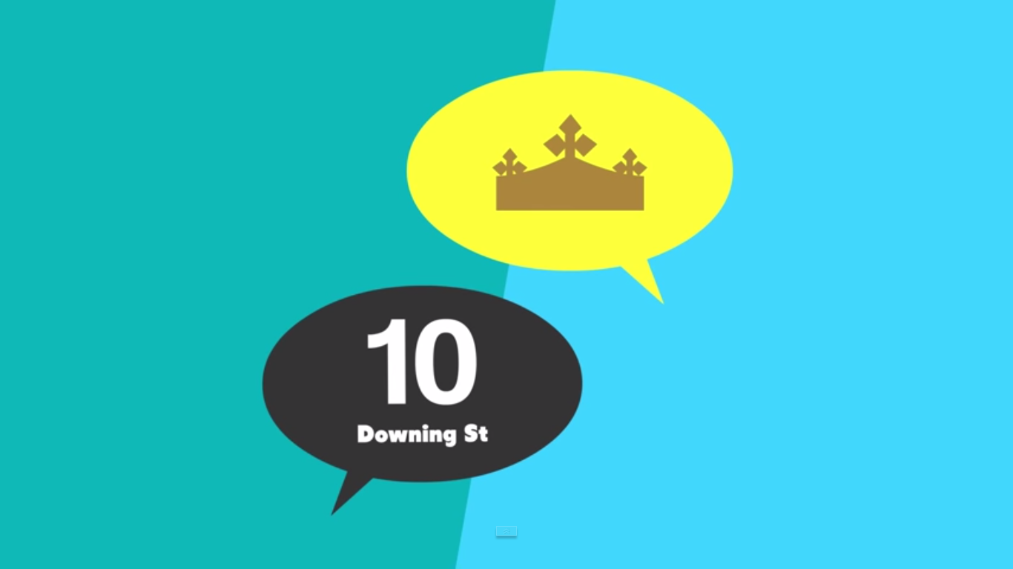
The Monarchs role is mainly ceremonial. They meet the Prime Minister once a week to hear what is going on in parliament and formally agree every new law.

Slide 11
The government has been elected to run the country and parliament makes sure the government is accountable to the public. MP’s and lords have the opportunity to challenge the governments policies in the house of commons. Its in these debates that they can share the views of their constituents and the public and how new policies may affect them.

Slide 12
Both houses in parliament share responsibility for making and shaping laws, but where do laws come from? A bill is a proposal for a new law or to change an existing law and comes from lot’s of places, like governing and opposition parties, public enquiries, civil servants or campaign groups. So how does an idea get turned into a law?

Slide 13
A proposal called the green paper is published which presents the governments ideas for future policy. This is open for public discussion with interested groups. Once findings are gathered a white paper is published which outlines a firmer plan for government policy. Cabinet Ministers must agree whether the proposal is taken forward. Once agreed a bill is drawn up and the Minister responsible for the policy introduces the bill to parliament for debate. And then if parliament agrees the queen makes the law official and it can be applied to society

Slide 14
In the UK, we live in a democracy which means power is in the hands of the people through our right to vote. Throughout history, lot’s of people in the UK have campaigned for the voting rights we have today. There are lot’s of different types of elections to vote in: General, local, European. Let’s take a closer look at how MP’s are elected to the House of Commons through the General Election.

Slide 15
General elections take place in the UK usually once every five years and every seat is up for grabs. On polling day, voters make a choice from a list of candidates. The candidate with the most votes then becomes that constituency’s MP. But how do we know who to vote for? Before elections, candidates need to campaign to get people to vote for them. Campaigning can involve handing out political leaflets, speaking in public debates, talking to people during door to door visits, and party political broadcasts.

Slide 16
Parties standing for election publish a declaration of their policies during the campaign, called a manifesto. Once elected an MP represents all their constituents – even the ones who didn’t vote, or voted for a different candidate. The party with the most MP’s elected form the government, and their leader becomes the Prime Minister. And if there’s a ‘hung parliament’ where there is no clear winner, then a minority government or a coalition government may be created or a fresh election held.

Slide 17
You have to be 18 or over to vote in the British General election.

Slide 18
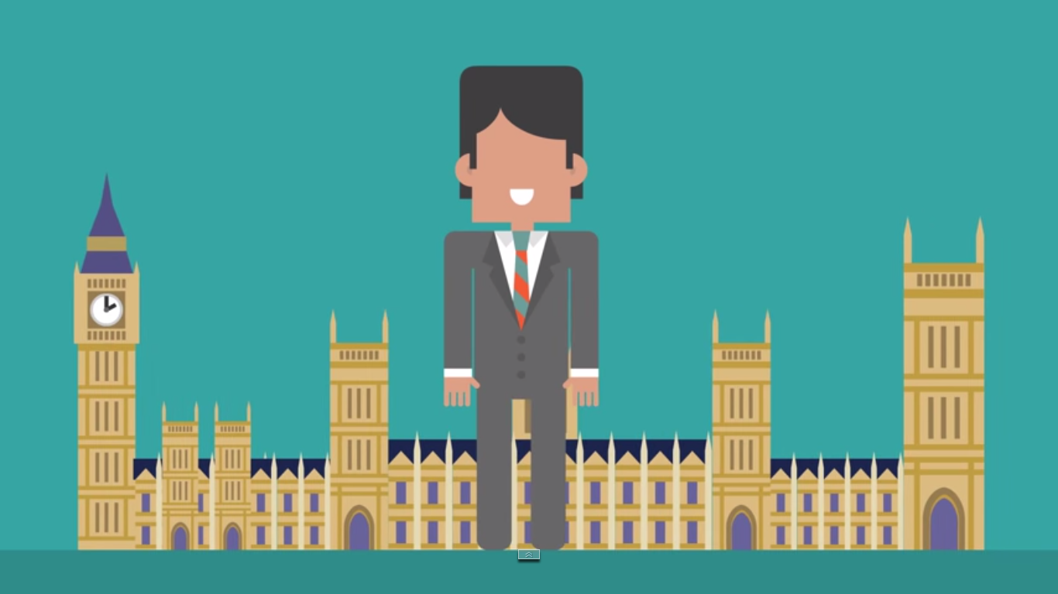
Thank you for listening
Please feel free to ask any questions

