Slide 1
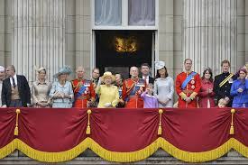
The British Monarchy
By Amy Towers & Tahira

Slide 2


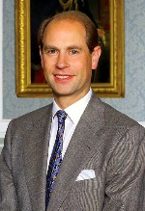
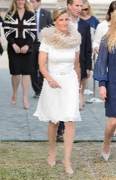
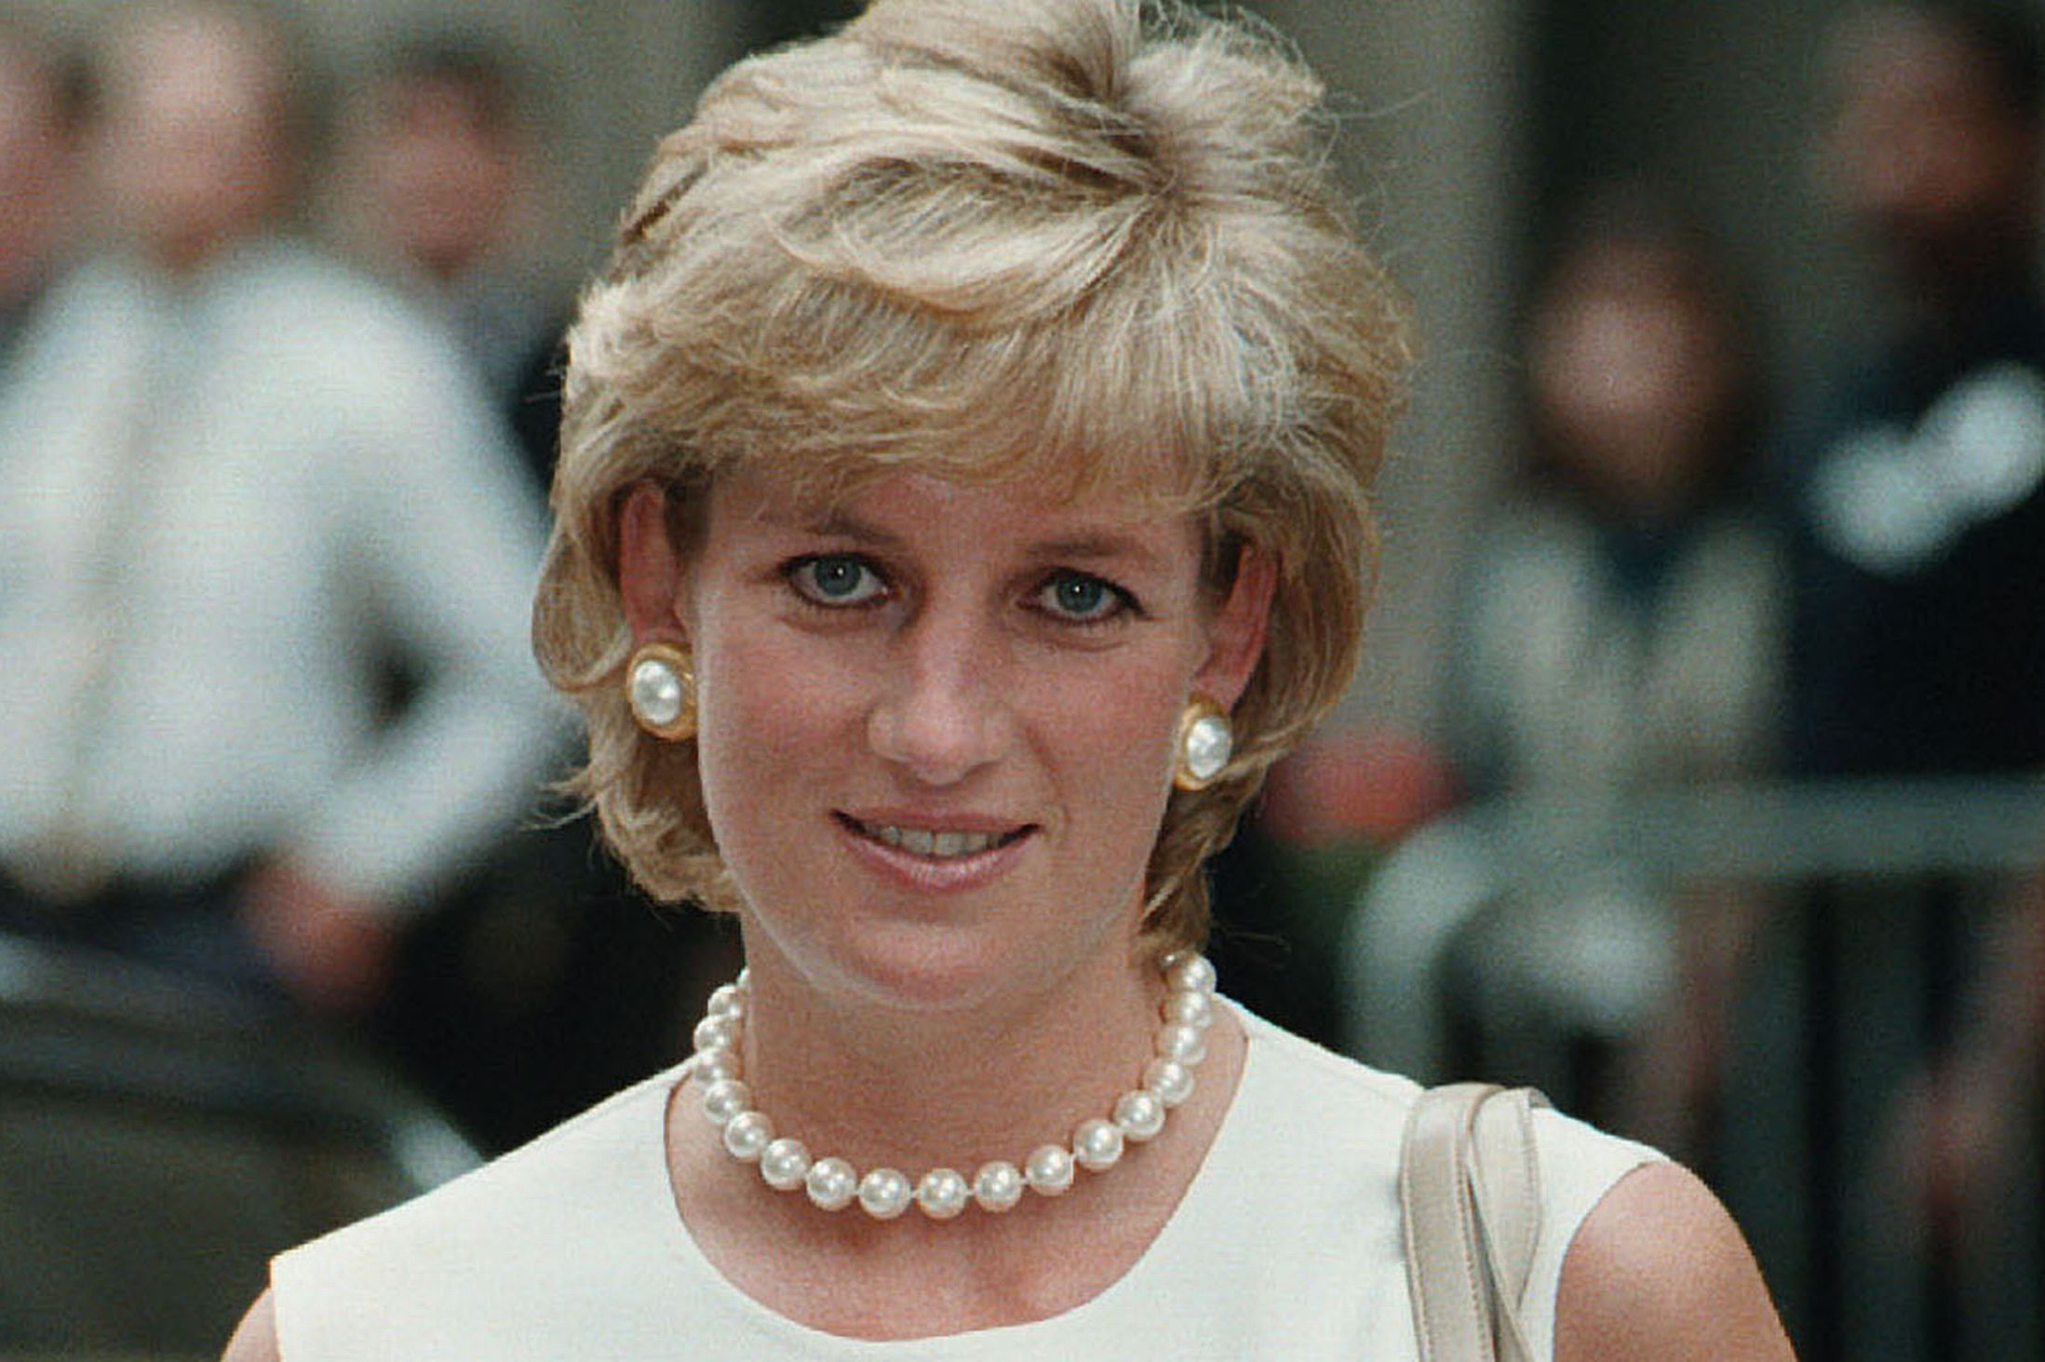
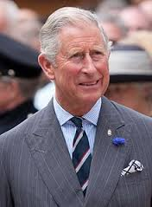
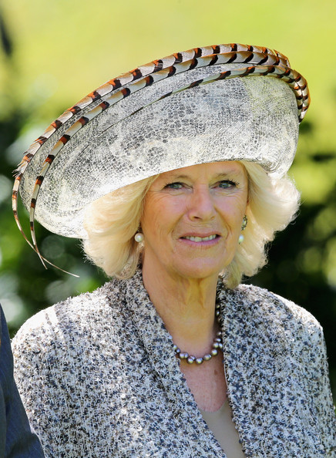
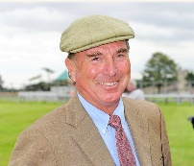
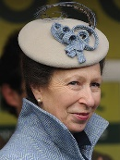
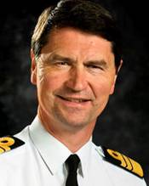
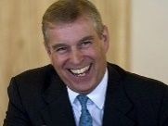
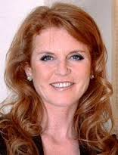
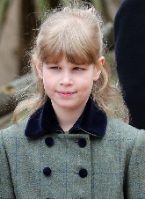
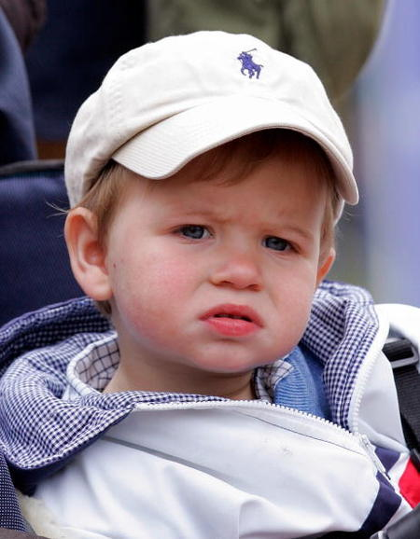
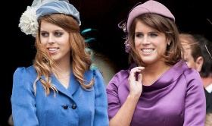
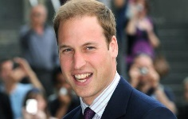
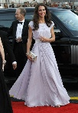
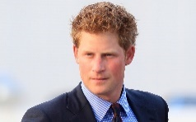
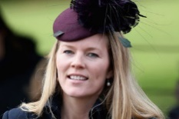
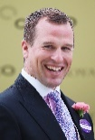
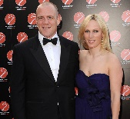
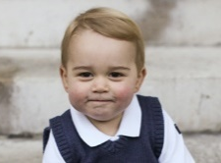
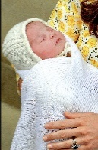
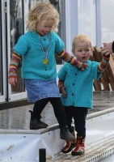
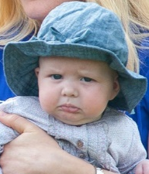
Queen Elizabeth II
Philip, Duke of Edinburgh
Diana, Princess of Wales
Charles, Prince of Wales
Camilla, Duchess of Cornwall
Captain Mark Phillips
Anne, Princess Royal
Vice-Admiral Timothy Laurence
Andrew, Duke of York
Sarah, Duchess of York
Edward, Earl of Wessex
Sophie, Countess of Wessex
William, Duke of Cambridge
Kate, Duchess of Cambridge
Harry, Prince Henry of Wales
Princess Beatrice of York
Princess Eugenie of York
Louise, Lady Louise Windsor
James, Viscount Severn
Autumn Phillips
Peter Phillips
Zara Tindall
Mike Tindall
Prince George of Cambridge
Princess Charlotte of Cambridge
Savannah
Isla
Mia Grace
Line of succession:
1st
2nd
3rd
4th
5th
FAMILY TREE

Slide 3
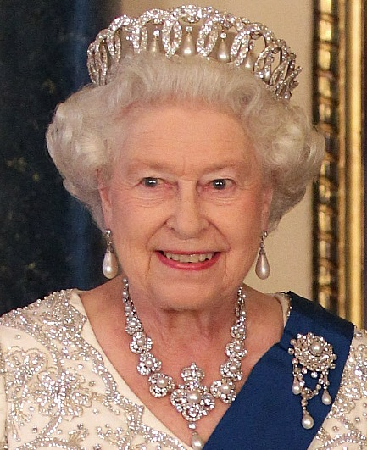
The Queen:
Elizabeth Alexandra Mary Winchester
Born 21st April 1926, Mayfair, London
Spouse Prince Philip, Duke of Edinburgh (M. 1947)
She is head of the Commonwealth and Supreme Governor of the church of England.

Slide 4
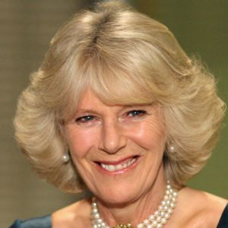

Prince Charles & Camilla:
Camilla Rosemary Mountbatten-Windsor
Born 17th July 1947, King’s College Hospital, London
Spouse Charles, Prince of Wales (M. 2005), Andrew Parker Bowles (M. 1973-1995)
Mainly she has royal duties including public appearances and patronages.
Charles Philip Arthur George
Born 14th November 1948, London
Spouse Camilla, Duchess of Cornwall (M.2005), Diana, Princess of Wales (M.1981-1996)
He is heir to the British throne, environmentalist, and served in the Royal Navy.

Slide 5
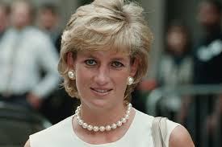
Diana, Princess of Wales:
Diana Frances Mountbatten-Windsor
Born 1st July 1961, Sandringham
Died 31st August 1997, Paris, France
Spouse Charles, Prince of Wales (M. 1981-1996)
Humanitarian work- e.g. her International Campaign to Ban Landmines, and royal duties.
Her Iconic Style Moments:

Slide 6
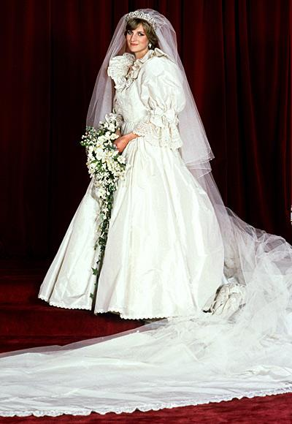
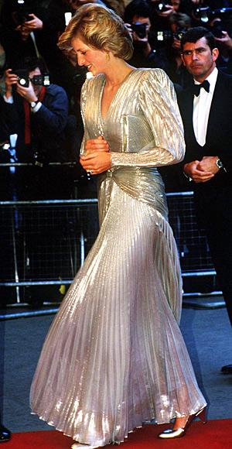

Slide 7
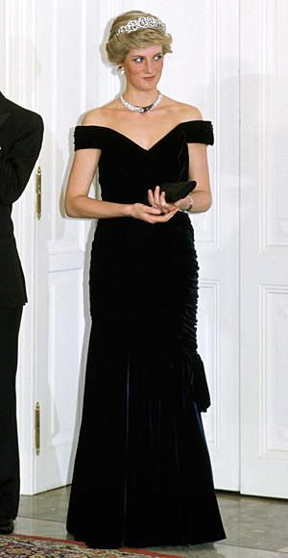
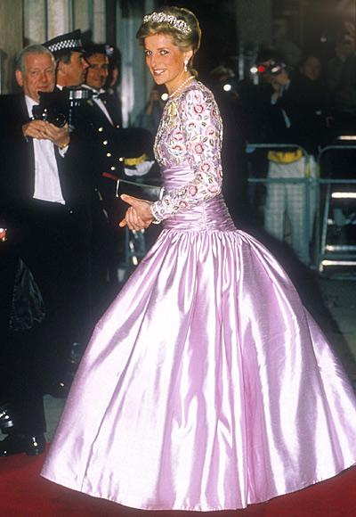

Slide 8
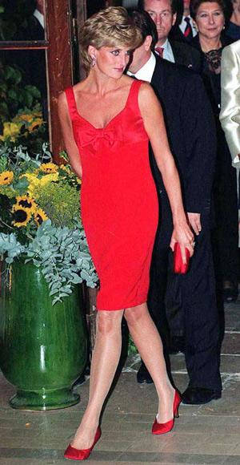
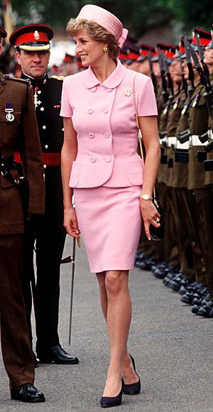
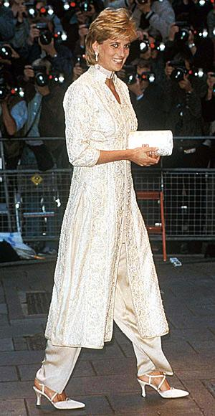

Slide 9

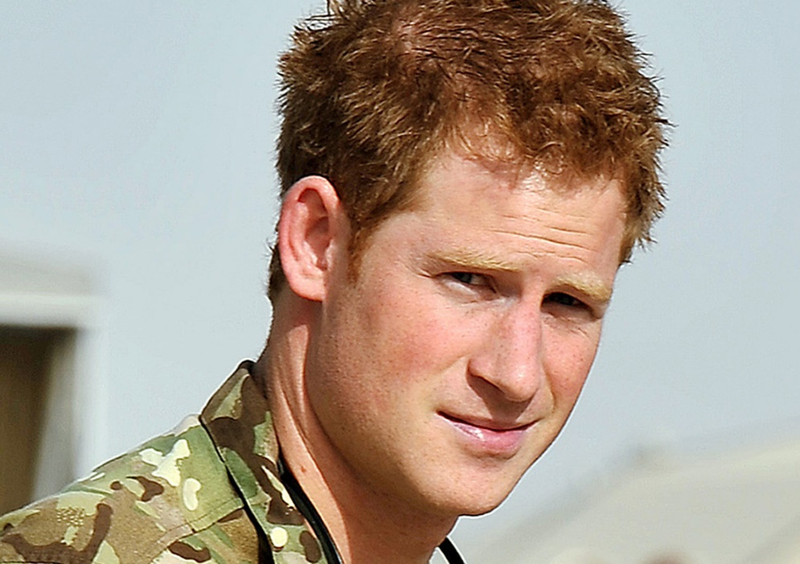
Prince Harry
Henry Charles Albert David
Born 15th September 1984, Paddington, London
Education Royal Military Academy Sandhurst, Eton College, Ludgrove School, Wetherby School
Soldier and Royal duties

Slide 10
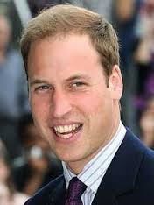
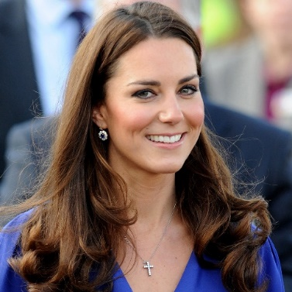
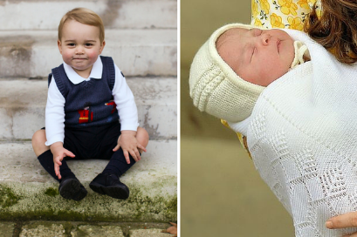
Prince William & Kate Middleton:
William Arthur Philip Louis
Born 21st June 1982
Spouse Catherine, Duchess of Cambridge (M. 2011)
Lieutenant in the Blues and Royals Regiment, part of the Search and Rescue Force in the RAF, Royal duties.
Catherine Elizabeth Mountbatten-Windsor
Born 9th January 1982, Reading
Spouse Prince William, Duke of Cambridge (M. 2011)
Worked in Jigsaw, but now her job is mainly royal duties like patronages and public appearances.
Their children Prince George & Princess Charlotte:

Slide 11
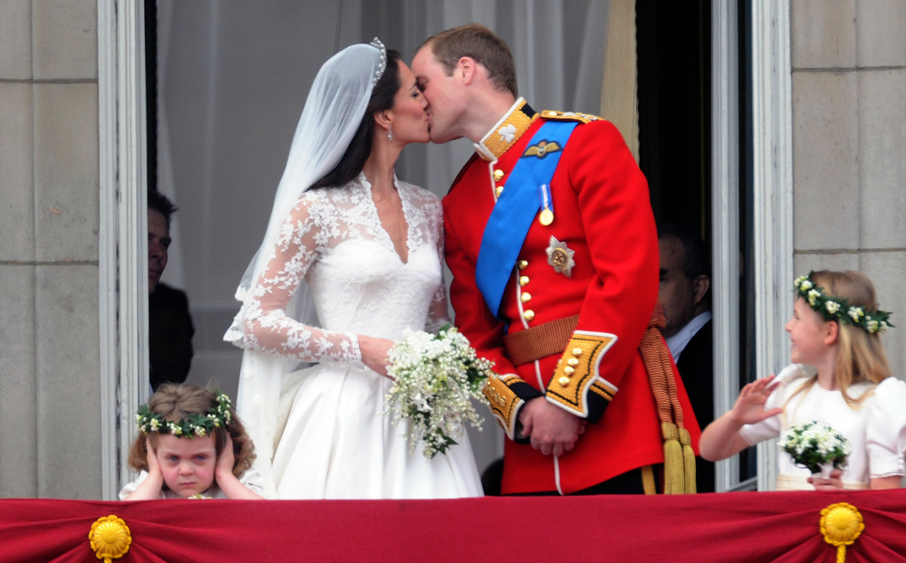
The Royal Wedding:

Slide 12
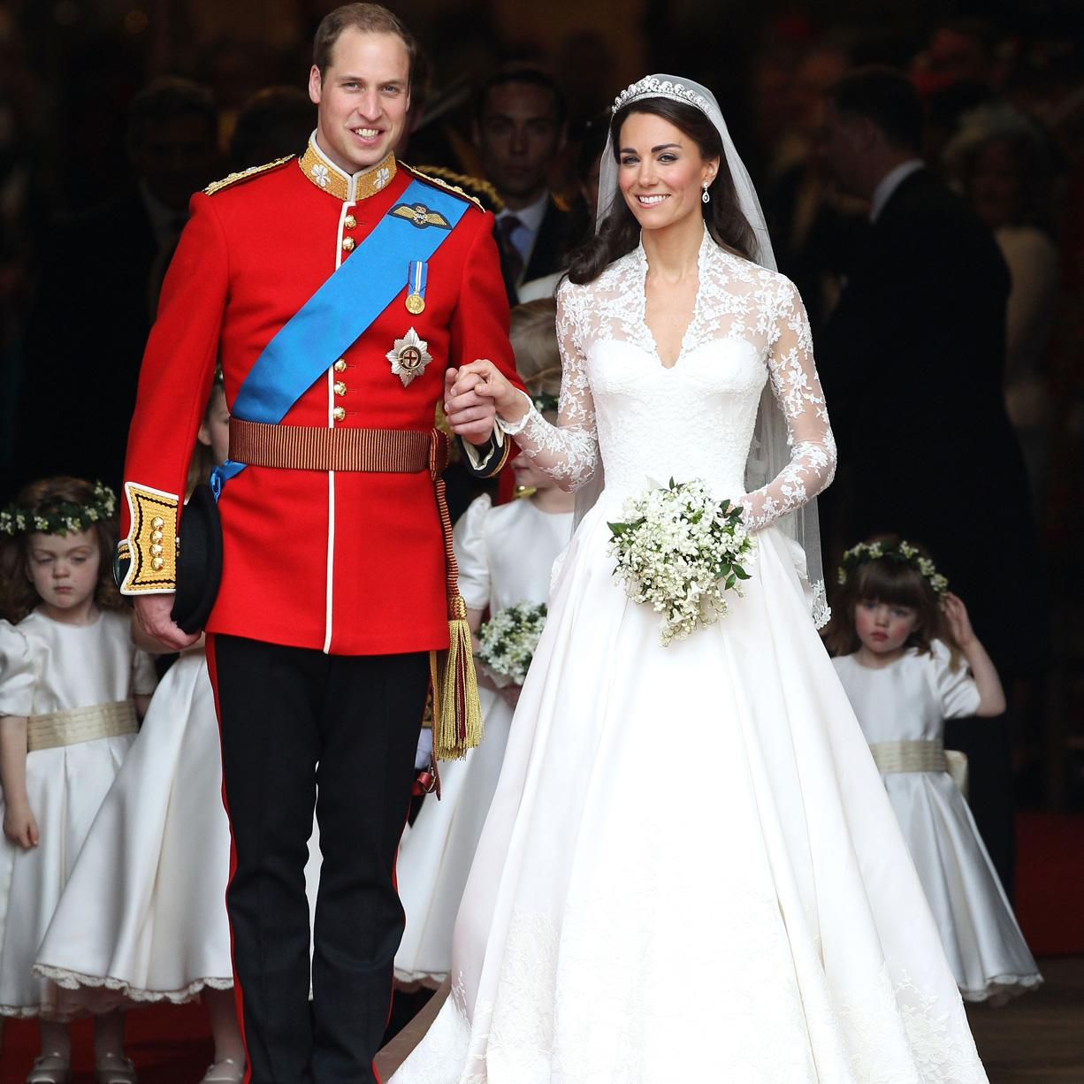

Slide 13
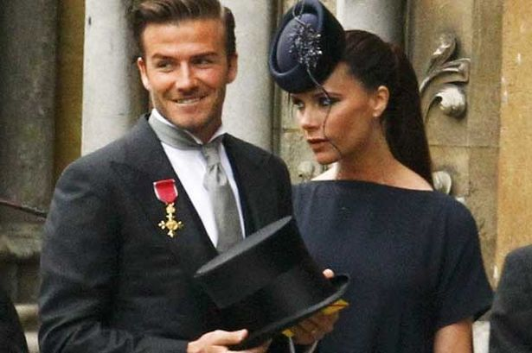
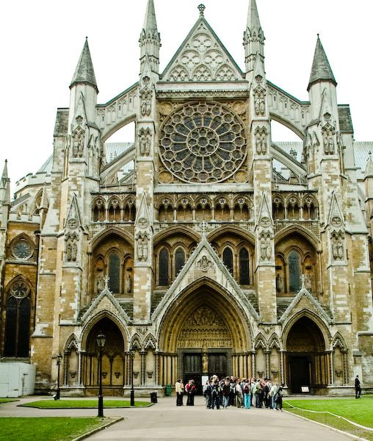
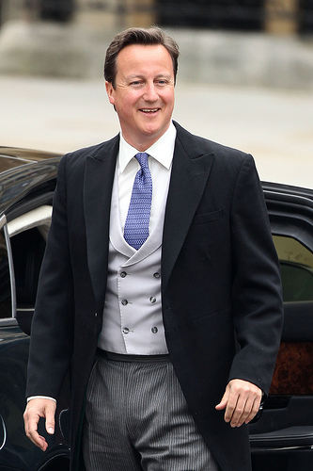
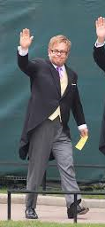

Slide 14
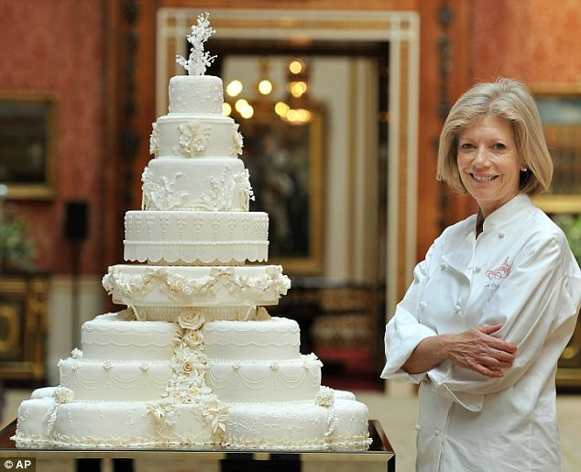

Slide 15
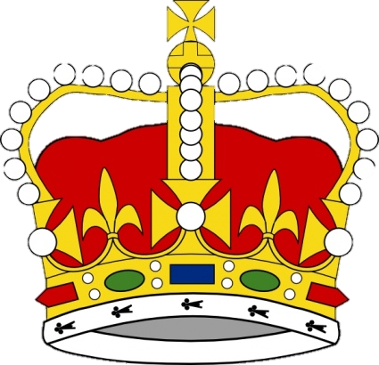
Thank you for listening to our presentation!

