Slide 2
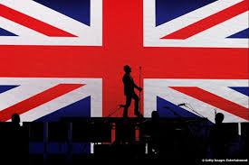
Brief Explanation
Through its history, the United Kingdom has been a major exporter and source of musical innovation in the modern and contemporary eras, drawing its cultural basis from the history of the United Kingdom, from church music, from Western culture and from the ancient and traditional folk music and instrumentation of England, Scotland, Northern Ireland and Wales. In the 20th century, influences from the music of the United States became most dominant in popular music. This led to the explosion of the British Invasion, while subsequent notable movements in British music include the New Wave of British Heavy Metal and Britpop. The United Kingdom has one of the world's largest music industries today, with many British musicians having had an impact on modern music.

Slide 3
Over the years…
British music had large influence over culture and society and has dominated the music and creative arts over decades. With each decade having its own style and trends.

Slide 4
60’s
The swinging 60’s had an extremely large following for music with Hippie culture basing itself around it with large festivals and summers of love. As well as this there was the emergence of the British invasion putting artists on a global scale.

Slide 5
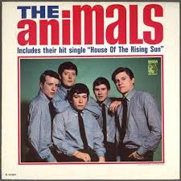
The British Invasion
The British Invasion brought in a new era/wave of music across the world

Slide 6
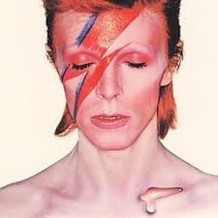
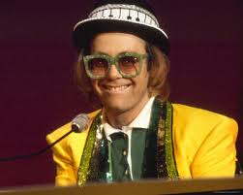
70’s
The 70’s came with a lot of dancing tunes with groove and funky trends, like Scar and Rock music.

Slide 7
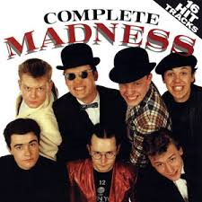
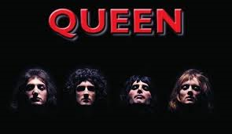
80’s
Now into the 80s music became much wider in variety along with the mergence of music videos and new forms of owning songs like castes for example.

Slide 8
90’s
The 90s saw a continuous wave of new fashions and strange styles brought on from the 80s. As well it came with many boy and girl bands very similar to eachother.

Slide 9
00’s+
Over the past ten or so years British music moved onto to electro tech styles. With house music and indie rock etc.

Slide 10
Taster
Famous songs….

Slide 11
TV AND RADIO
There are 3 public bodies are responsible for television and radio throughout England
The British Broadcasting Corporation (BBC)
The Independent Television Commission (ITC)
The Radio Authority
We in Britain watch TV on average 25 hours of every week. Television viewing is Britain's most popular leisure pastime
We have got five main channels in Britain (BBC1, BBC2, ITV1, Channel 4 and Channel 5)
The BBC has been providing regular television broadcasts since 1936
There are about 130 daily and Sunday newspapers
British newspapers include the following:
The Daily Mail, The Daily Telegraph, The Financial Times,
The Guardian, The Independent, The Times, Western Mail
and Echo, The Sun, The Mirror, The Herald, Written by Rachel.

Slide 12
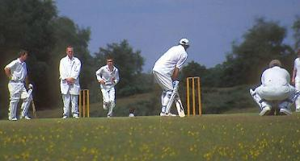
England’s national sport: cricket
Most popular sport: soccer (football)
Rugby: this sport used to be played by the rich upper class only
Tennis: Wimbledon
Traditionally, visitors eat strawberries and cream while watching the game
Polo: brought to Britain from India in the 19th Century by army officers
Boxing Day Hunts: Traditionally it is a day for fox hunting
Boxing Day is the following day after Christmas Day
18 February 2005: hunting with dogs became a criminal offence

Slide 13
Barclays Premier league
It was
It was founded in 1992
It is a UK based football league
It is one of the most watched and successful team
There are 20 teams, 38 games

Slide 14
Locations
These are the location of all 20 teams in the premier league

Slide 15
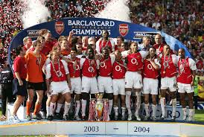
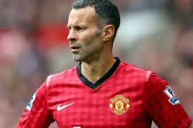
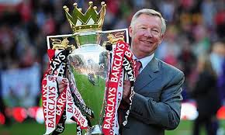
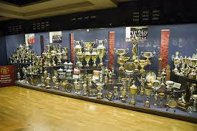
Records and achievements
Most titles won – Manchester united (13)
Most goals scored – Alan Shearer (260)
Best Manager: Sir Alex Ferguson
Most Appearances: Ryan Giggs (598)
Best Team: 2003–04 Arsenal

