Slide 1
Changes in the Textile Industry
www.theeducationforum.co.uk

Slide 2
Increasing demand
The rapid rise in population after 1750 meant there was a need for industries like textiles to produce much more. The Domestic system could not meet that demand.
There was a need for the sort of mass production which only industrial factories could deliver
The first industry in Britain to industrialise was textiles (clothing)
Most of the textile industry was based in the North of England – Lancashire and Yorkshire

Slide 3
Textiles In the Domestic System
There were 3 stages all labour intensive and involving degrees of skill:
Carding: separating strands of usual wool from the raw mass using a ‘hand card’ – a toll like a big hair brush – usually carried out by women and children
Spinning: Joining the strands or cards into continuous thread – again undertaken by women and children using spinning wheels
Weaving: weaving or joining the thread into material or cloth – a more skilled job performed by men using a simple hand loom
Over the next few years all these processes were revolutionised by the adoption of new technology and factory processes

Slide 4
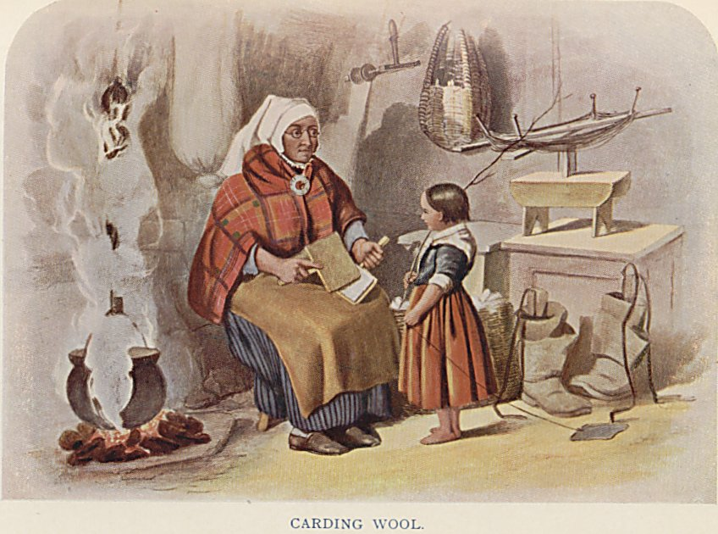
Carding

Slide 5
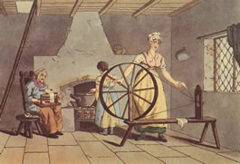
Spinning

Slide 6
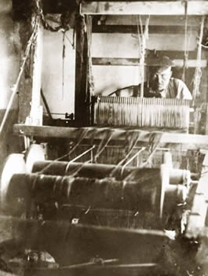
Handloom Weaving

Slide 7
Flying Shuttle
In 1733 John Kay of bury invented a weaving machine called a flying shuttle. This was still hand powered but it sped up the weaving process considerably. The reaction from his workers was so angry that he had to flee to France.
However from 1750 its use became widespread and hand spinners were unable to keep up with the weavers

Slide 8
James Hargreaves
In 1764 James Hargreaves of Blackburn solved this problem by inventing a new foot powered spinning machine called the spinning Jenny which could spin eight threads at a time as opposed to the one of the traditional spinning wheel
By 1788 there were 20,000 spinning jennies being used in Lancashire.
Workers again reacted against the new technology and following an arson attack on his property he was forced to flee to Nottingham
A spinning jenny can be seen in operation here
https://www.youtube.com/watch?v=gM6T2mb-C6M

Slide 9
Water Frame
In 1769 Richard Arkwright developed the first water powered spinning machine the ‘water frame’
It was too big for the home and so Arkwright built mills or factories to house them
The water frame sped up spinning dramatically and Arkwright became extremely wealthy and invested in further factories
Listen to Arkwright here https://www.youtube.com/watch?v=AN8HaQezcbU

Slide 10
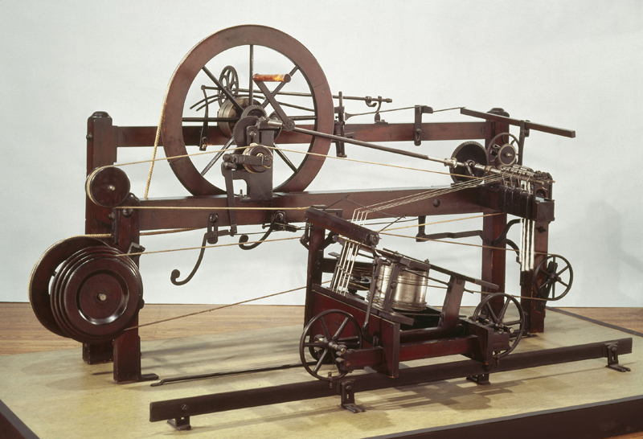
Crompton’s Mule
In 1799 Crompton invented a water powered spinning machine called the ‘mule’ which produced a smoother strong thread than that of Arkwright’s water frame

Slide 11
Weaving
Spinning was now much quicker than weaving even with the flying shuttle.
This meant that handloom weavers were in great demand and could demand high wages and had relatively comfortable life styles.
This all came to a grinding halt when Edmund Cartwright invented a power loom which very quickly became adopted in factories threatening the livelihoods of handloom weavers and triggering the Luddite rebellion
See a power loom in operation here
https://www.youtube.com/watch?v=ArO-qUT7Zmw

